Slide 1


Slide 2
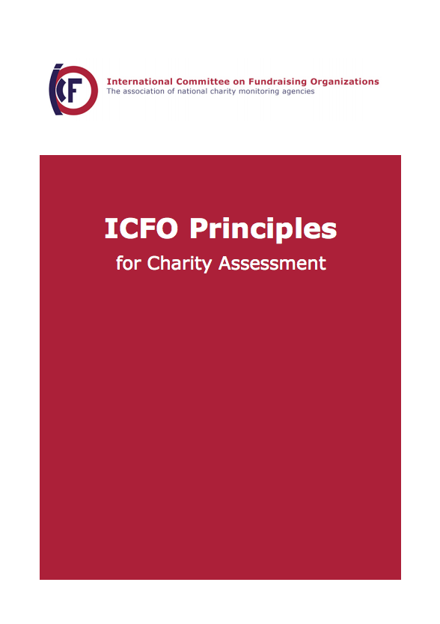
How to Assess Charities
Similar challenges
How to set standards
How to assesses charities
How to inform on the result
Download: www.icfo.org
Local context
Notes:
Nevertheless ICFO-members have agreed on shared principles to assess charities in a fair and credible manner.
The principles address the main areas of building donors trust:
How to set standards for charities
How to assess charities against such standards
3. How to inform on the result of the assessment

Slide 3







7 Key Areas to Address in Standards
Public Benefit
Governance
Finances
Efficiency
Effectiveness
Integrity
Transparency
Notes:
The Principles identify 7 key areas you should cover as charity monitoring agency with your standards:
Define what it means to fulfill a mission, which is dedicated to the public benefit.
Aim for good governance: Ask charities to have an active governing body. And effective supervisory structures. Make sure they fulfill their responsibilities. And that they act with the necessary independence.
Have a look at the finances: The financial information must be complete, accurate, true and provide a fair view of the financial situation.
Ask for transparency about the costs for fundraising and overhead.
Address effectiveness: Either ask the charity to assess regularly the result of its activities. Or at least promote it.
Include Integrity: Charity must be ethical, truthful, accurate and neither misleading nor aggressive.
This is not only true for Fundraising and Communication, but for the behavior of the entire organization, as the Oxfam-Scandal showed us recently.
Promote Transparency: Charities should inform the public freely available about their background, their finances, their activities and their results.
Of course: ICFO-members will determine in their standards in more detail, what this means in their local context.

Slide 4

Setting Standards
Use a multi-stakeholder approach.
Fix standards in writing and publish them.
Make sure you own the standards.
Review standards periodically and adjust them if necessary.
Notes:
To ensure that standards will be broadly accepted.
That they can be met.
And that you can enforce them.
Be aware of the following:
Use a multi-stakeholder approach to develop the standards. Involve charities, donors and other groups of interest before you decide.
Fix the standards in writing, so charities and donors know what they assure.
Make sure you own the standards, so you can review them periodically and adjust if necessary.

Slide 5

2. How to Assess Charities
Notes:
To treat charities fairly and at the same time
make sure the assessment is credible for donors
you should keep in mind a few points:

Slide 6
Assessment: Credibility and Fairness (1/2)
Assess against the set of standards.
Follow a structured process.
Use current information about the charity.
Work with trained assessors, not related to the charity.
Assessors act on direct behalf of you and report to you.
Apply the same assessment criteria in the same situation.
Document the assessment and its outcome.
Review the result to assure the quality of the assessments.
Notes:
Assess charities against a set of standards, which you have developed as described before.
Follow a structured process, which is similar for similar charities.
Make sure you base your judgement on current information, not on unrealistic plans or wish full thinking
Work with trained assessors, which are not related to the charity. They may be your staff, your volunteers or others (mandated by you)
Make sure assessors not only act on your behalf but also report to you.
Apply the same assessment criteria in the same situation. (Which means you can apply different benchmarks for different charities)
Document the assessment made and the outcome. (So you can track and verify when needed)
Review the result of the assessments to assure its quality.

Slide 7
Assessment: Credibility and Fairness (2/2)
When standards are not fully met, give the charity an opportunity to provide additional information and to comment.
You make the final judgment, disclose how to appeal.
Re-assess a charity on a regular basis (e.g. 2 years).
Ensure there is no conflict of interest, if you charge fees.
Regulate the reconsideration of the final decision.
Review the assessment process periodically.
Notes:
When standards are not fully met, give the charity an opportunity to provide additional information and to comment.
Make sure you make the final judgment. Disclose how to appeal, if the charity does not agree with it.
Re-assess a charity on a regular basis (ICFO recommends every 2 years).
You may or may not charge fees for the assessment. But if you charge: Ensure there is no conflict of interest. (Do not depend on a few big ones).
Regulate the reconsideration of the final decision.
Review the assessment process periodically.
Again: Assessment procedures will reflect the local context once they are implement in more detail.

Slide 8

3. Inform on the Result
Notes:
Finally monitoring organizations let donors know, which Charites are trustworthy and how they determined this

Slide 9
Inform on the result
Publish the standards.
Disclose the assessment process and fees that apply.
Inform on result of your assessment.
Give the charity the opportunity to comment on the negative findings of a report you will publish.
Let charities know before the assessment how the results will be published.
Do not publish rankings or ratings to compare charities
Notes:
As charity monitoring agency acting according to ICFO-Principles:
You publish your standards, so donors know what you had ask from trustworthy charities.
You disclose the assessment process and fees that apply, so donors know your relationship with the charity.
You inform on the result of your assessment, so donors know a charity meets the standards (you may use a seal, a report, a list or other useful forms).
Should you publish negative findings of a report, you give the charity the opportunity to comment on it
You let charities know before the assessment how the results will be published.
You don’t publish rankings or ratings, as you do not want to compare apples to pear
Many of us go beyond that. We educate the public to give with generosity and advise donoers how to donate wisely. Some of us even publish warnings.

